Slide 1
[ADD ORGANIZATION NAME]
[ADD DATE]
Notes:
INSERT CUSTOMIZED WELCOME REMARKS FOR YOUR GROUP
TERRITORIAL ACKNOWLEDGEMENT
This workshop is being conducted on the shared, unceded territory of the Lil’wat People, known in their language as ĹiÌwat7úl, and the Squamish People, known in their language as Skwxwú7mesh. We respect and commit to a deep consideration of their history, culture, stewardship and voice.

Slide 2
Agenda
X:XX MEETING OPENING
Land acknowledgement
Welcome and framing
Introductions and check in
Background on Whistler Sessions
Understanding the scenarios
X:XX USING THE SCENARIOS
Step 1 – Personal reflection
Step 2 – Threats and opportunities
Step 3 – Implications
Step 4 – What must we do?
What is emerging?
X:XX CLOSING THE MEETING
Next steps
Check out - What are we seeing now?
X:XX END OF THE MEETING

Slide 3
Workshop objectives
To share The Whistler Sessions Scenarios
To use the scenarios as a strategic tool to identify implications for participants and their organizations, sector, or community and identify robust and resilient courses of action
To continue to build a collaborative network of leaders committed to creating a better future for Whistler

Slide 4
Team agreements
Be Present
Keep Confidences
Equity of Voice

Slide 5
Check in
[ADD CHECK IN QUESTION]
[ADD TIME AVAILABLE FOR ACTIVITY]
Notes:
Share name
What question are you holding as we get started?
Why did you accept the invitation to be here today?
What are my hopes and expectations of today?

Slide 6
Background on the Whistler Sessions
Notes:
First we are going to talk about how the scenarios came to be
The Whistler Sessions scenarios initiative is convened by the Resort Municipality of Whistler. It is creating a community and region-wide network of people who are committed to collaborate for a better future for Whistler.

Slide 7
What moment does Whistler find itself in?
COVID provided an opportunity to pause and reflect on our forward trajectory and the inherent assumptions
Blind spots uncovered in the COVID working group discussions
How do we need to think about the future in a more robust way?
Notes:
COVID provided an opportunity to pause and reflect on our forward trajectory and the inherent assumptions
A series of Community Conversations, online open houses, were held to check in on the community during this unprecedented time.
Out of those meetings, a group called the Whistler Recovery Working Group was convened to discuss how to respond to and then eventually recover from the pandemic.
Blind spots uncovered in the COVID working group discussions
We could see that Whistler’s success had created some blind spots – Tourism is assumed to continue to grow, community is assumed to remain the same, the natural surroundings will continue to provide critical infrastructure for residents and visitors – trails, shade, wildlife habitat, views, air quality, snow.
What were we taking for granted?
We asked ourselves what can we not see that we need to consider now while we have time to shift how we work together?
How do we need to think about the future in a more robust way?
How do we Build Back Better – but what does that mean? What are we aiming for?

Slide 8
What lies ahead?
Who will live, work, and feel a sense of belonging in Whistler?
What kind of community will Whistler be?
Who will be able to afford to be in Whistler, and who will want to?
What could the future hold for Truth and Reconciliation in Whistler?
How might development unfold in the face of both pressures for growth and limits to growth?
How might climate change affect the community and economy, and how might Whistler respond?
How effective might those responses be?
Notes:
While some things about the future are constant, such as Whistler’s geography, the process to develop the scenarios was the chance to explore what is uncertain about the future, considering both factors within the community and external to the community.

Slide 9
How should we look at the future?
What is happening? How do we see, from our different perspectives, the complex current reality in and around Whistler?
What could happen? How could our lives unfold over the decades ahead?
What could and must we do? How must we act – individually and together – to recover from COVID-19 and achieve our Vision?
Notes:
Decided to use a transformative scenario process to explore some key questions.

Slide 10
What is a scenario?
A scenario is…
“An outline of the plot of a play, film, opera, etc., with details of scenes, situations, etc.; a postulated sequence of future events.”
An internally-consistent hypothesis about the future that is relevant, challenging, plausible, and clear
A story about what could happen in the world around us—about what is possible
A scenario is not…
A story about what will happen: a forecast or prediction
A story about what should happen: a vision or proposal or plan
A story about what we could do: an option

Slide 11
Criteria for useful scenarios
Scenarios are stories of possible futures that are:
Relevant
Addressing the most important circumstances and concerns
Challenging
Making the invisible visible and questioning current mindsets and narratives
Plausible
Evidence-based and believable
Clear
Distinct, accessible and memorable
Notes:
Relevant – Address the most important circumstances and concerns
Challenging – Making the invisible visible and questions current mindsets and narratives
Plausible – Evidence-based and believable
Clear – Distinct, accessible and memorable

Slide 12
The Scenarios
Notes:
The “Whistler Sessions” Scenarios are stories about what could happen in Whistler’s future, from 2022 to 2050.
The intent of the scenarios is to provide a structure and language to help the Whistler community have discussions about the future.

Slide 13
Why these four scenarios?
Why now?
Notes:
Whistler faces uncertain times for which there is no pre-existing roadmap to guide the way. In an uncertain future, scenarios help build shared capacity to talk together about how things could unfold.
Thinking about the future together can help people collaborate to create the future they want.
The scenarios do not aim to predict the future or state a desired vision.
They aim only to provoke new thinking, make opportunities and threats more visible, and enable richer, more useful conversations about what Whistler must do to build the future it wants.

Slide 14
Notes:
Have person assigned to read or share their overview of this scenario in three minutes.

Slide 15
Thinking that drives decision making | Community wellbeing and belonging | Relationality between Líl̓wat Nation, Squamish Nation and Whistler | Housing and affordability | Environment, sustainability and response to climate change | Development, economy and infrastructure | Culture, arts and education
Densification and eventually growth in response to tourism and housing demand | Urbanization increases community diversity, with systemic racism growing and becoming more visible. Growing workforce is less aware of available social services | Attempts to advance Truth and Reconciliation results in new economic opportunities for First Nations | Affordable housing achieved through densification followed by growth | Per-capita decrease but overall increase in GHG emissions, and loss of green spaces and park land due to development | Densification, urbanization and regional integration. Increased commuter congestion | Facilities and programs for artists and education expand as population grows

Slide 16
Ever-increasing pressures for growth and densification lead Whistler to urbanize, regionally integrate, and diversify both economically and demographically.
As the resort town grows into a mountain city, more housing options and services become available. With Lower Mainland growth and expansion of the Vancouver International Airport, the mountain operator attracts more visitors through marketing campaigns and business strategies, driving further pressure to grow. As the town grows economically and in population, more stakeholders gain influence over its future, including those outside of Whistler and Canada. Major expansions in housing, commercial, transit, and tourism infrastructure come alongside bold affirmations of commitments to sustainability and Truth and Reconciliation.
As more diverse people participate in Whistler’s government and businesses, including Squamish Nation and Ĺiĺwat7ú Nation members, reports of systemic racism become more prevalent. As the population grows, the underhoused population also grows as increases in affordable housing stock struggle to keep pace with demand. Market-driven pressures for growth come into tension with sustainability and other commitments, eventually leading to a loss of trails, park land, habitat, and missed emissions targets. First Nations derive economic benefits from growth and gain influence, but the learning and healing aspects of Truth and Reconciliation commitments make limited progress as the deep roots of systemic racism become more visible.

Slide 17
Notes:
Have person assigned to read or share their overview of this scenario in three minutes.

Slide 18
Thinking that drives decision making | Community wellbeing and belonging | Relationality between Líl̓wat Nation, Squamish Nation and Whistler | Housing and affordability | Environment, sustainability and response to climate change | Development, economy and infrastructure | Culture, arts and education
Restraint and innovation for housing and resilience to climate change | Locally housed workforce contributes to culture and sense of belonging | Partnerships to develop innovative water storage, fire suppression, and micro hydro energy projects | Affordable housing achieved through innovation and repurposing | Innovation to build climate-resilient infrastructure, protect habitat, and achieve net-zero by 2050 | Innovative densification and net-zero, low-growth development | Education emphasizes resilience to climate change, land-based learning

Slide 19
Faced with increasingly stretched capacity and the urgent need to become more resilient to the earlier-than-anticipated effects of climate change, innovation becomes a dominant driving force in decision making throughout Whistler.
Policy shifts aim to restrain growth, cap visitation, aggressively pursue water management, wildfire preparedness and emergency responses, and commit all new housing development to affordable housing. The mountain operator and other businesses are partners with the municipality to cap visitation and develop low-carbon transit, and they partner with the Squamish Nation and the Ĺiĺwat7ú to develop renewable energy.
This agenda aims to realize Whistler’s vision as a climate-resilient resort that preserves a sense of belonging for its residents. Implementing this vision proves politically challenging, government, business, and community leaders must incur costs and endure pains to realize the agenda. First Nations leadership grows in energy, resources management, and international sporting events, and youth leaders become more engaged in government. More innovative housing options and diverse tourism offerings become available, and Whistler becomes seen as the world’s most climate-resilient resort town.

Slide 20
Notes:
Have person assigned to read or share their overview of this scenario in three minutes.

Slide 21
Thinking that drives decision making | Community wellbeing and belonging | Relationality between Líl̓wat Nation, Squamish Nation and Whistler | Housing and affordability | Environment, sustainability and response to climate change | Development, economy and infrastructure | Culture, arts and education
Leveraging wealth to manage limits to growth | Decentralized pockets of community in wealthy subdivisions. Addiction and mental health challenges grow among the workforce | Wealthy philanthropists fund opportunities for First Nations | High housing costs with workforce living out of town in high-density, dorm-style housing | Increased snowmaking to preserve the ski industry and increased GHG emission due to larger houses with few restrictions | Housing and tourism infrastructure that caters to the wealthy | Arts and culture are vibrant in decentralized pockets, and private education expands

Slide 22
Tourism demand grows, pressure on affordable housing increases, and Whistler’s government manages its growth strictly.
As pressures mount on businesses and services, growing operating costs lead to increased prices. Tourism revenue increasingly comes from wealthier tourists who stay for longer and spend more, serving as a “self-limiting” strategy for managing visitation while growing the economy. The economy becomes dominated by large businesses based outside of Whistler, and the mountain operator’s influence on decision making grows.
The only new employee housing is dorm-style rental housing far away from employees’ places of work. More second homeowners engage in local government and philanthropy, and social service priorities become driven by the mountain operator’s and philanthropists’ personal interests and resources. Bolstered by an increasingly wealthy population, local philanthropy supports new economic opportunities and cultural activities. New activities include diversified opportunities to learn about Squamish Nation and Ĺiĺwat7ú culture and history, as well as offerings represented as “Indigenous” that some see as culturally appropriative.
Whistler’s “mountain culture” shifts into a form more influenced by wealthy visitors and residents. Long-term and new wealthier residents enjoy a high quality of life and vibrant culture in their communities, while systemic gentrification puts economic burdens on the workforce that exacerbate mental health and wellbeing challenges.

Slide 23
Notes:
Have person assigned to read or share their overview of this scenario in three minutes.

Slide 24
Thinking that drives decision making | Community wellbeing and belonging | Relationality between Líl̓wat Nation, Squamish Nation and Whistler | Housing and affordability | Environment, sustainability and response to climate change | Development, economy and infrastructure | Culture, arts and education
Building a new community following collapse | Rebuilt community based on connection to the land and uniqueness of Whistler | Reformed governance that elevates First Nations perspectives. First Nations lead a return to a more traditional use of and reverence for the land. | Housing demographics shift with less second home ownership and reduced need for workforce housing. | Climate change drives collapse followed by a regenerative, land-based economy with reduced GHG emissions | Resources scarce amid global, national, and local crises. Repurposed infrastructure | Arts and culture help drive the economy

Slide 25
Global climate and financial crises converge to devastate economies both internationally and in Canada. Whistler’s recovery from the COVID-19 pandemic is unstable, wildfires inflict massive damage to its infrastructure, and snowfall declines faster than anticipated due to climate change.
These intersecting crises lead to an economic collapse in Whistler, with many small businesses and residents leaving due to untenable levels of uncertainty. The mountain becomes locally owned and managed.
A shrinking population brings more affordability, as well as a concentration of community values based on common ground between those who remain: a connection to the land and the uniqueness of Whistler as a place, and its rich history that is held by the Squamish people and Lil’wat people. These values drive a new agenda of rebuilding post-collapse, including reformed governance structures that centre around the Nation’s perspectives. The community builds a new regenerative economy, including Indigenous-led tourism offerings based on arts, culture, and the land.

Slide 26
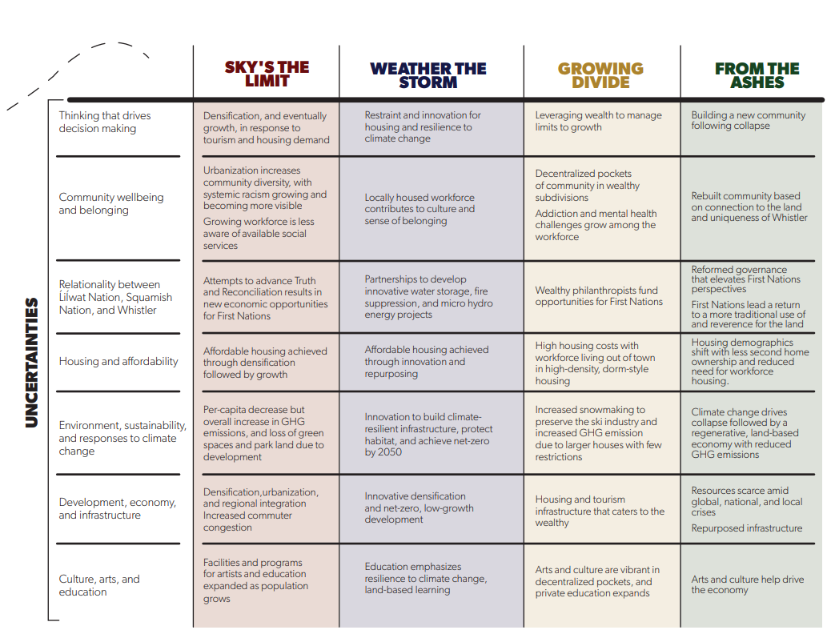
Notes:
This is a summary of the uncertainties of the four scenarios.
Defining the key uncertainties about our future was the backbone of the scenario development. Different possible outcomes within each uncertainty were mapped and then grouped together to form each of the stories.
Our job today is not to critique the stories. Our job is to work with them and use them to help us shape priorities – eg. Policies, Decisions, Budgets, Advocacy, Communications

Slide 27
Take a minute to reflect…
What feelings arose for you as you listened to these four stories?
What thoughts arose for you as you listened to these four stories?
What scenario are you contributing to enacting?
What is one question you are asking yourself?

Slide 28
Using the Scenarios
Notes:
The scenarios help make visible what’s invisible.
They help us question current mindsets and things that we have taken for granted.
They challenge our thinking.

Slide 29
For each scenario…
If this scenario were happening, what opportunities would it present to my organization/sector/issue area?
If this scenario were happening, what threats would it present to my organization/sector/issue area?
If you want to test your strategy… If this scenario were happening, what are the strengths and weaknesses of my strategy to respond to it?

Slide 30
Looking at the set of scenarios…
What are the implications for your community/organization/issue area or sector?

Slide 31
Based on the implications you’ve identified…
What are possible actions you could take going forward?
(Brainstorm, one idea per post-it)
Actions are something you can start, stop, or keeping doing, from
An adaptive orientation: We cannot and should not and need not change our context; we must accept it and adapt to it
A transformative orientation: Our context is or could become unsustainable or unacceptable; we cannot and should not and need not adapt to it; we must try and change it

Slide 32
What are our highest leverage actions?
High Impact
Low Impact
High Effort
Low Effort

Slide 33
Next Steps
[include next steps here]

Slide 34
Check Out
What are you seeing now that you didn’t see at the beginning of this workshop?

Slide 35
Appendix
Use the following slides if relevant for your agenda design

Slide 36
Ever-increasing pressures for growth and densification lead Whistler to urbanize, regionally integrate, and diversify both economically and demographically.
EXTERNAL PRESSURES TO GROW
INCREASED GROWTH AT ODDS WITH SUSTAINABILITY AND SENSE OF PLACE
GHG EMISSION GOALS NOT MET
LOCAL ECONOMY GROWS WITH INVESTMENTS FROM STAKEHOLDERS OUTSIDE WHISTLER
AFFORDABLE HOUSING STOCK DOES NOT KEEP PACE WITH POPULATION GROWTH
DESPITE THE PROMISES OF RECONCILIATION EFFORTS, RACISM INCREASES

Slide 37
Faced with increasingly stretched capacity and the urgent need to become more resilient to the earlier-than-anticipated effects of climate change, innovation becomes a dominant driving force in decision making throughout Whistler.
RESOURCE AND EMERGENCY MANAGEMENT BECOMES A SHARP FOCUS FOR COMMUNITY
ACTIVE PURSUIT OF GROWTH MANAGEMENT STRATEGIES
INNOVATIVE MEASURES TAKEN SO WORKFORCE CAN LIVE LOCALLY
FIRST NATIONS AND LOCAL GOVERNMENT COLLABORATE ON CLIMATE CHANGE MITIGATION
FIRST NATIONS LEADERSHIP IN ENERGY, RESOURCES MANAGEMENT AND INTERNATIONAL SPORTING EVENTS
TRANSPORTATION PLANNING FOCUSES ON CAR-FREE TRANSPORT
ECO-TOURISM OFFERINGS INCREASE

Slide 38
Tourism demand grows, pressure on affordable housing increases, and Whistler’s government manages its growth strictly.
WHISTLER’S CHARACTER IS INFLUENCED BY WEALTHIER RESIDENTS AND GUESTS
LOCAL PHILANTHROPY SUPPORTS NEW ECONOMIC OPPORTUNITIES AND CULTURAL ACTIVITIES
BED CAPS ARE STRONGLY ENFORCED
LIMITED GROWTH HAS HELPED PROTECT WILDLIFE HABITAT IN WHISTLER
BY 2023, 90% OF THE LOCAL BUSINESSES IN OPERATION IN 2022 HAVE SOLD THEIR OPERATIONS TO LARGER BUSINESSES

Slide 39
Global climate and financial crises converge to devastate economies both internationally and in Canada. Whistler’s recovery from the COVID-19 pandemic is unstable, wildfires inflict massive damage to its infrastructure, and snowfall declines faster than anticipated due to climate change.
ACCELERATING CLIMATE CHANGE FORCES RESORT TO FOCUS ON GUEST EXPERIENCES IN THE SUMMER, SPRING AND FALL
INTENSE WILDFIRE DESTROYS COMMUNITY INFRASTRUCTURE AND DEVASTATES TOURISM ECONOMY
OPPORTUNITIES EMERGE FOR RECONCILIATION THROUGH COMMUNITY PLANNING AND REFORM GOVERNANCE
MANY RESIDENTS LEAVE WHISTLER, WITH SOME STAYING DUE TO A STRONG CONNECTION TO PLACE

Slide 42
Global leaders in the art and science of systemic change

Slide 43
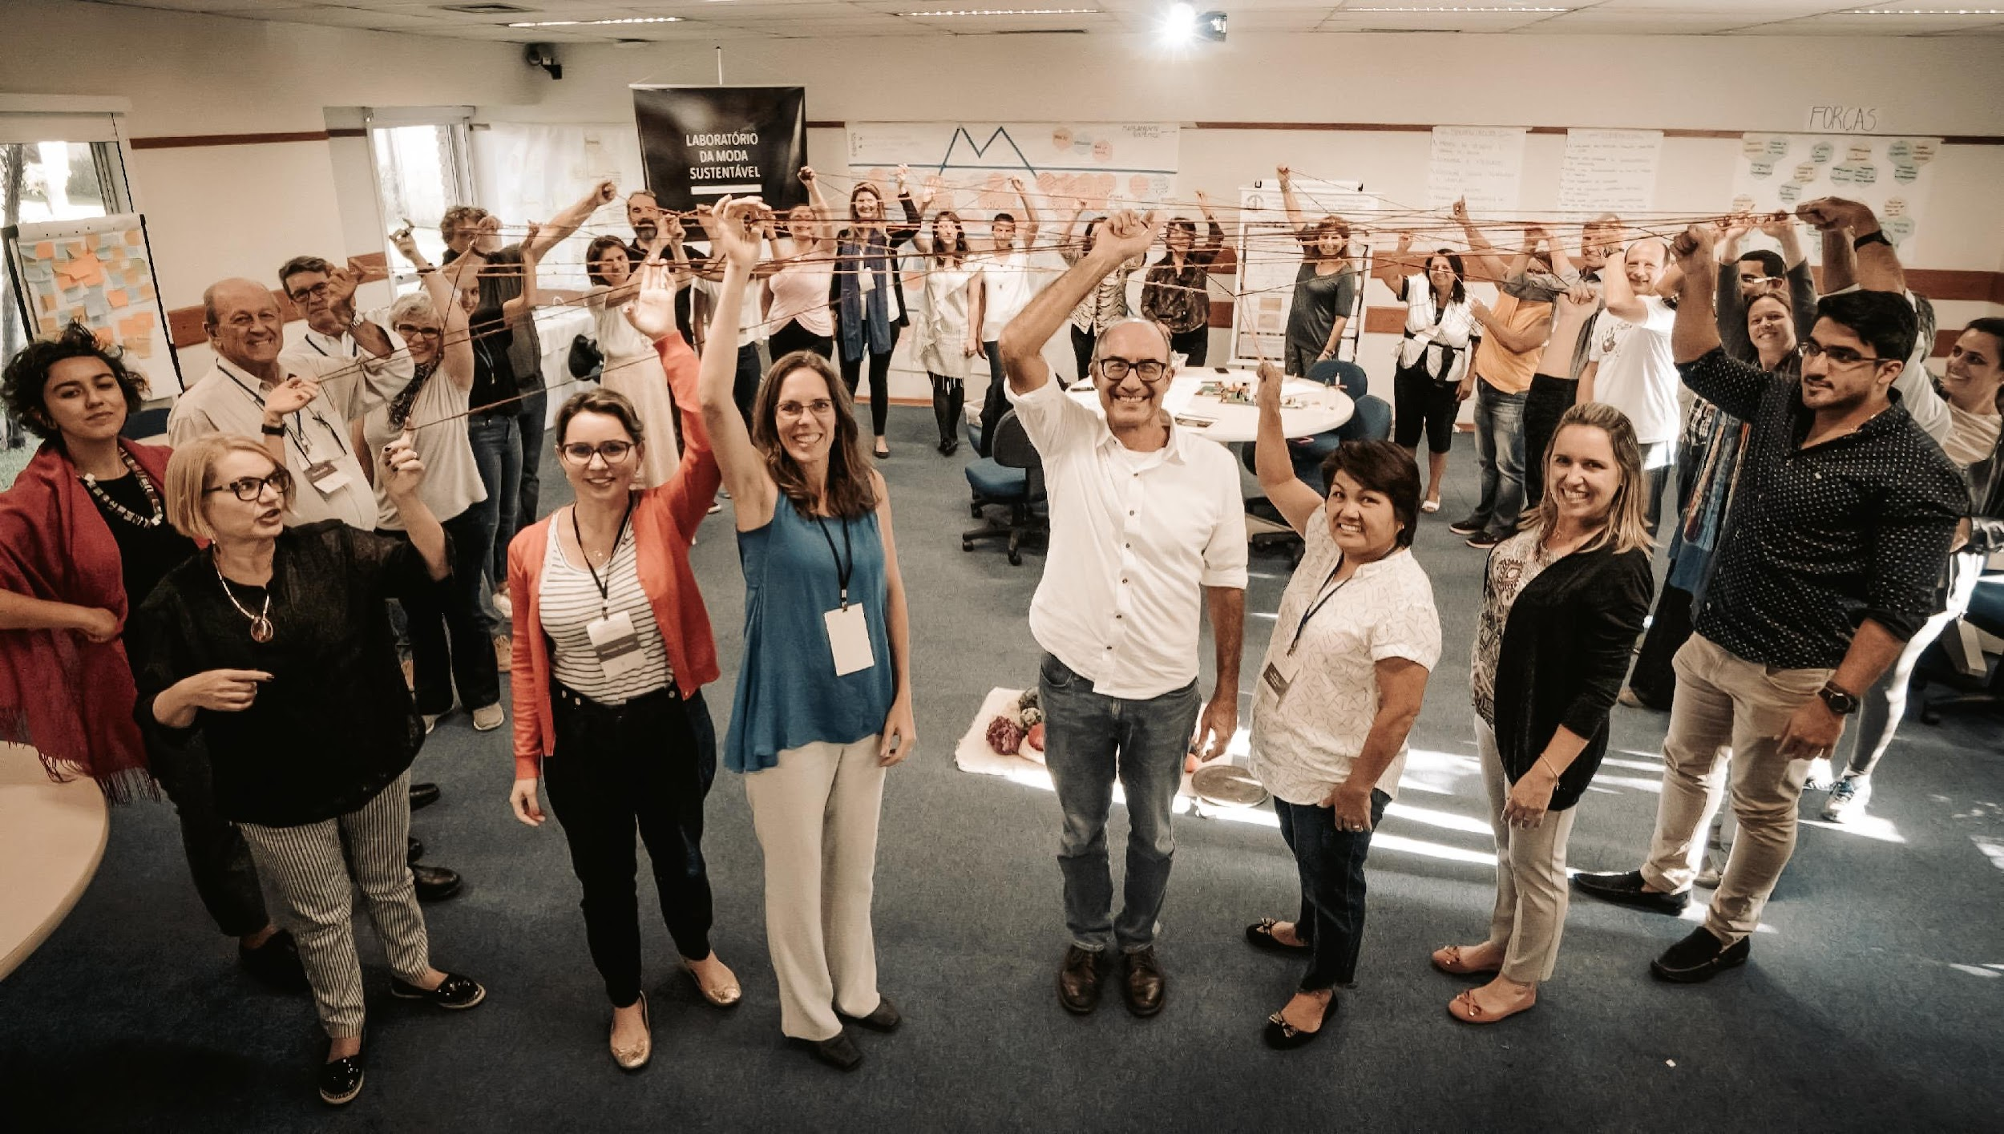
WHO
WE ARE
Leaders have trusted us for 30 years to guide them through uncharted territory in a rapidly evolving and complex environment.
Reos Partners is a strategic global consulting firm that addresses complex, high-stakes challenges around the world.

Slide 44
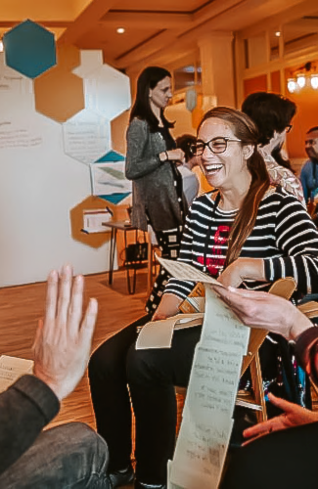
ENVISIONING NEW FUTURES
Our methodologies seek to not only understand the future but to shape it. Our structured and creative process helps diverse actors to envision possible scenarios and to act to mitigate threats and realize opportunities.
ENABLING TRUE COLLABORATION
Understanding of a system comes from living in it. Complex problems don’t respond to monolithic, top-down solutions. They require a team that reflects the diversity of people involved. Our process brings the full range of knowledge—including local, Indigenous, and informal knowledge—to the conversation and to potential solutions.
OUR APPROACH
UNBLOCKING STUCK SITUATIONS
Combining imagination and rigour, our process enables shared understandings, stronger relationships, and clearer intentions, thereby unblocking polarized situations and creating the potential for action to shape a better future.
MAKING REAL PROGRESS IN THE REAL WORLD
Our agile process supports experimenting with prototype solutions. Working in a “social laboratory,” teams generate ideas and then head out again into the world to test, learn, and scale their solutions.

Slide 45
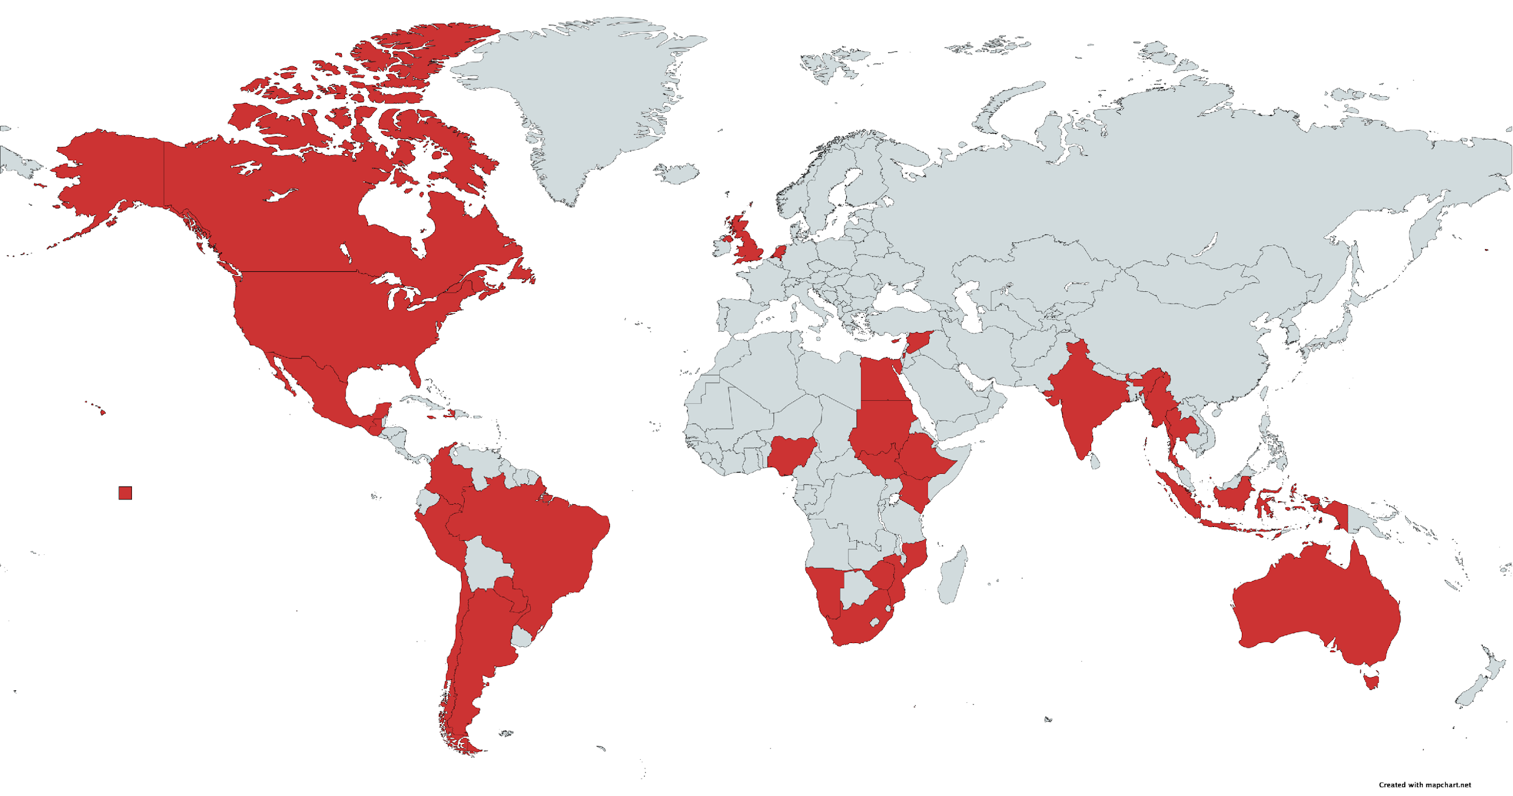
REOS’ TRANSFORMATIVE SCENARIO PLANNING PROJECTS
Notes:
Health & Well-Being
Wahbung - Our Tomorrows Imagined: Creating scenarios for Mino Pimatisiwin – the good life- for Manitoba First Nations, in partnership with the Assembly of Manitoba Chiefs, the Southern Chiefs Organization, Manitoba Keewatinowi Okimakanak Inc, First Nations Health and Social Secretariat of Manitoba, and The University of Manitoba.
Health System Scenarios: Catalyzing strategic thinking and conversation about the possible futures of health and health equity in the United States, and the opportunities, risks, and choices these futures present, in partnership with Robert Wood Johnson Foundation.
EDUCATION
Charleston Shared Future: Working to ensure educational success for all children in the Charleston County School District by imagining possible futures and, in the process, developing system understanding and collaboration skills, in partnership with Charleston County School District.
CIVIL SOCIETY & GOVERNANCE
Alerta Democrática: Reflecting on the challenges of democracy in Latin American and collectively developing alternative futures for the continuous development of the region, in partnership with the Ford Foundation, Open Society Foundations, Fundação Avina.
Destiny Ethiopia, Four Scenarios of Possible Futures: bringing together national leaders to work on possible futures for the country and identify possible paths to take to create a better future for Ethiopians, in partnership with the Forum of Federations in Ethiopia.
Civil Society Scenarios for Brazil: Inspiring and challenging Brazilian public, private, and civil society stakeholders to reflect and act on the role of civil society in addressing social, cultural, economic, and environmental issues in the country, in partnership with D3 Articulation for Democracy, Dialogue, and Rights, General Secretariat of the Presidency of the Republic of Brazil, ABONG, Avina, C&A Institute.

